Slide 1
C39FF Finance and Financial Reporting
Financial Statements
Income Statement (Profit & Loss Account)
Statement of Financial Position (Balance Sheet)

Slide 2
The Main Financial Statements
1
Income Statement
2
Statement of Financial Position
3
Cash Flow Statement

Slide 3
Capex v Opex
Capital expenditure
Revenue or operating expenditure
Which Statement?!

Slide 4
Income Statement
It shows how the business is controlling costs
It can provide a basis for assessing the market position of the business
It enables a review of the income generated and payments made
Performance can be better assessed

Slide 5
Measuring and reporting financial performance
Income statement
Profit (or loss) = total revenue for the period minus total expenses for the period
Provides information on:
  how effective the business has been in generating wealth
  how the profit was made

Slide 6
Grouping types of expenses
Cost of sales
Selling and distribution costs
  Selling costs
  Advertising
  Delivery costs
Administrative expenses
  Telephone
  Electricity
  Insurance
  Legal fees
  Any other expenses that are not allocated elsewhere

Slide 7
Recognising expenses
Accrued expenses (accruals)
  Arise when the expense for the period is more than the cash paid during the period
  Example :
    Company A paid £4,000 electricity in the year to 31 Dec 2020. At the year end, it had not paid its final electricity bill which arrived in January 2021, amounting to £1,500.
    Must increase electricity expense by £1,500, and create a new current liability called accrued expenses of £1,500

Slide 8
Prepaid expenses (prepayments)
  Arise when the amount paid for the period is more than the expense for the period
  Example :
    Company B also has a year end of 31 December 2020. During the year, it paid £24,000 for an annual insurance premium, which covers the period 1 April 2020 until 31 March 2021.
    Must reduce insurance expense by £6,000, and create a new current asset called prepaid expenses of £6,000

Slide 9
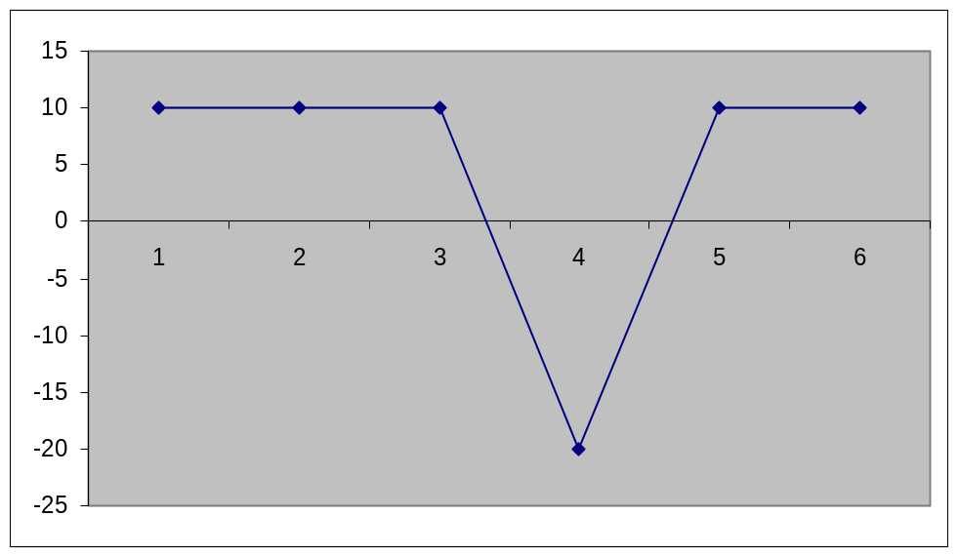
Depreciation
Spreads the cost of an asset over its estimated useful life
Avoids under or over stating profit
Example: company usually makes £10,000 profit each year. It buys a lorry costing £30,000 in year 4.

Slide 10
Calculating depreciation
Car purchased for £10,000. Estimated useful life 5 years, with no scrap value anticipated.

Slide 11
Effect of depreciation on accounts
Each year, the depreciation charge is included as an expense in the income statement
The asset in the statement of financial position is reduced by the same amount
Over several years, the written-down value of the asset will get lower and lower

Slide 12
Statement of financial position
It shows how the business is financed and how these funds are deployed
It can provide a basis for assessing the value of the business
Relationships between assets and claims can be assessed
Performance can be better assessed

Slide 13
Assets
An item owned which is expected to bring future economic value to the organisation.
Increases a firms value.
Tangible Assets
Intangible Assets
Fixed or Non-current Assets
Current Assets

Slide 14
Classification of assets
Assets are divided into
  non-current (fixed) (> 1 year)
  current assets (< 1 year)
Typical business assets
  Property
  Plant and equipment
  Fixtures and fittings
  Patents and trademarks
  Investments
  Inventory
  Trade receivables

Slide 15
Valuation of assets
Usually included at historic cost
Non-current assets
  depreciated each year, over their expected useful lives
  Can be revalued to current market value
    Eg rise in property prices
  If significant drop in value, reduce figure to recoverable amount
    Drop in value of shares owned by a company

Slide 16
Liabilities
Claims of anyone else against the business, such as:
  Loans
  Trade payables
  Tax due

Slide 17
Classification of liabilities
Liabilities are classified dependent on their payment / repayment / settlement terms
Current Liabilities
  Repayable within 1 year
Non-Current Liabilities
  Repayable after 1 year

Slide 18
Summary
The Financial Statements may be used to assess performance.
The Income Statement (Profit & Loss Account) shows the sales generated, costs incurred and surplus or deficit remaining.
Expenses are classified into groups to simplify presentation.
The ‘accruals concept’ matches the cost to the activity.
Depreciation spreads the cost of an asset over its useful economic life.
The Statement of Financial Position (Balance Sheet) shows the total assets, liabilities, equity and the business value.

